Slide 1

E-commerce User Behavior Analysis
29th Annual Virtual Student Symposium on RSCA, 2021
Professor: Dr. Jongwook Woo
By:
Taya Stewart Mounkam
Raymond Delgado
Navaneeth Visagan
Frank Chen
Ninelia Talverdi

Slide 2

The rise of online retailers has enabled the consumer to buy many products online.
The data generated from user activity on ecommerce websites is extremely valuable.
This data provides businesses with in-depth view of their consumer base (e.g., consumer preferences).
This data can also answer questions like “what brands do people prefer?”
Our goal is to analyze ecommerce data and provide insight that can be used to enhance the ecommerce platform.
Introduction
Notes:
T

Slide 3

Data Source : Kaggle.com
Dataset URL : https://www.kaggle.com/mkechinov/ecommerce-behavior-data-from-multi-category-store
The file contains behavior data for one month (Oct 2019) from a large multi-category online store.
Original File Size : 5.28 GB
Number of Rows : 42,449,681
Number of Columns : 9
Number of Files : 1
About the Dataset
Notes:
T

Slide 4

Technical Specification
Cluster version: Oracle Big Data Compute Edition
Cluster number of nodes: 3 nodes
# of OCPUs: 8
CPU speed: 2.20 GHz
Memory size: 160 GB
HDFS Capacity: 802 GB
Local storage: 202 GB
Notes:
T

Slide 5





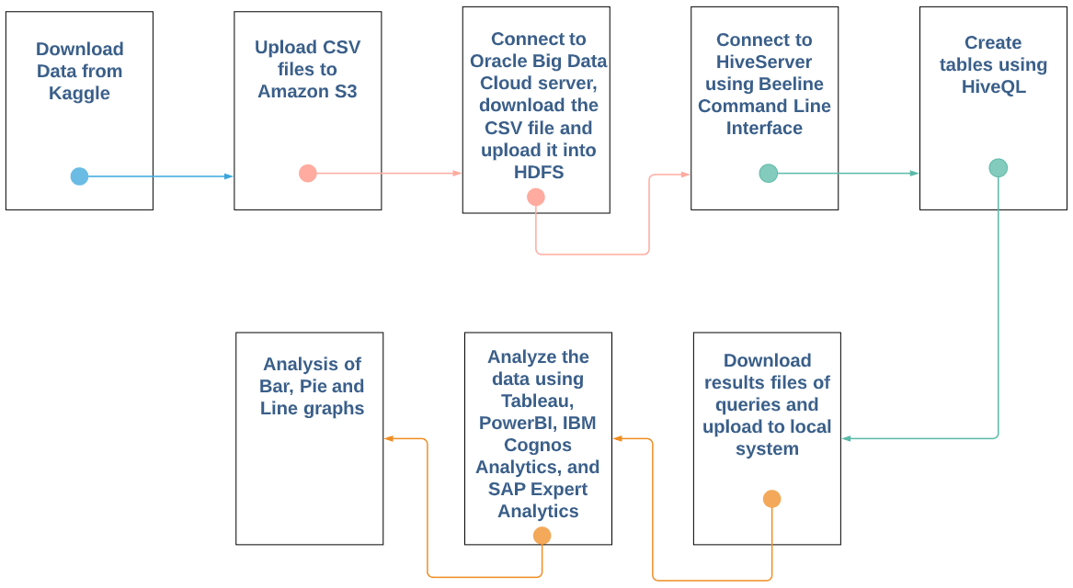



Flowchart
Notes:
T

Slide 6

Data Challenges
The original dataset was too large to upload to our Hadoop File System
The timestamp is not usable so it has to be parsed into the core components
User ID, product ID and session ID all had alphanumeric values

Slide 7

Data Cleaning
Subset = 78 MB
Number of Rows = 26,560,622
event time(unique) = 2,558,113
session id(unique) = 6,419,694
user id(unique) = 2,323,036
Cleaned the dataset: Filtered out missing values
Generated new columns from the existing columns: day, hour, and event_precentage

Slide 8




Data Analysis and Visualization
Notes:
T

Slide 9
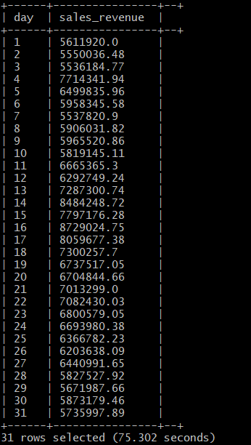
Query 1
Goal: To find the daily sales revenue in the month of October
SELECT day, ROUND(SUM(price), 2) AS sales_revenue FROM ecommerce_view where event_type='purchase' GROUP BY day ORDER BY day ASC;
Notes:
T

Slide 10
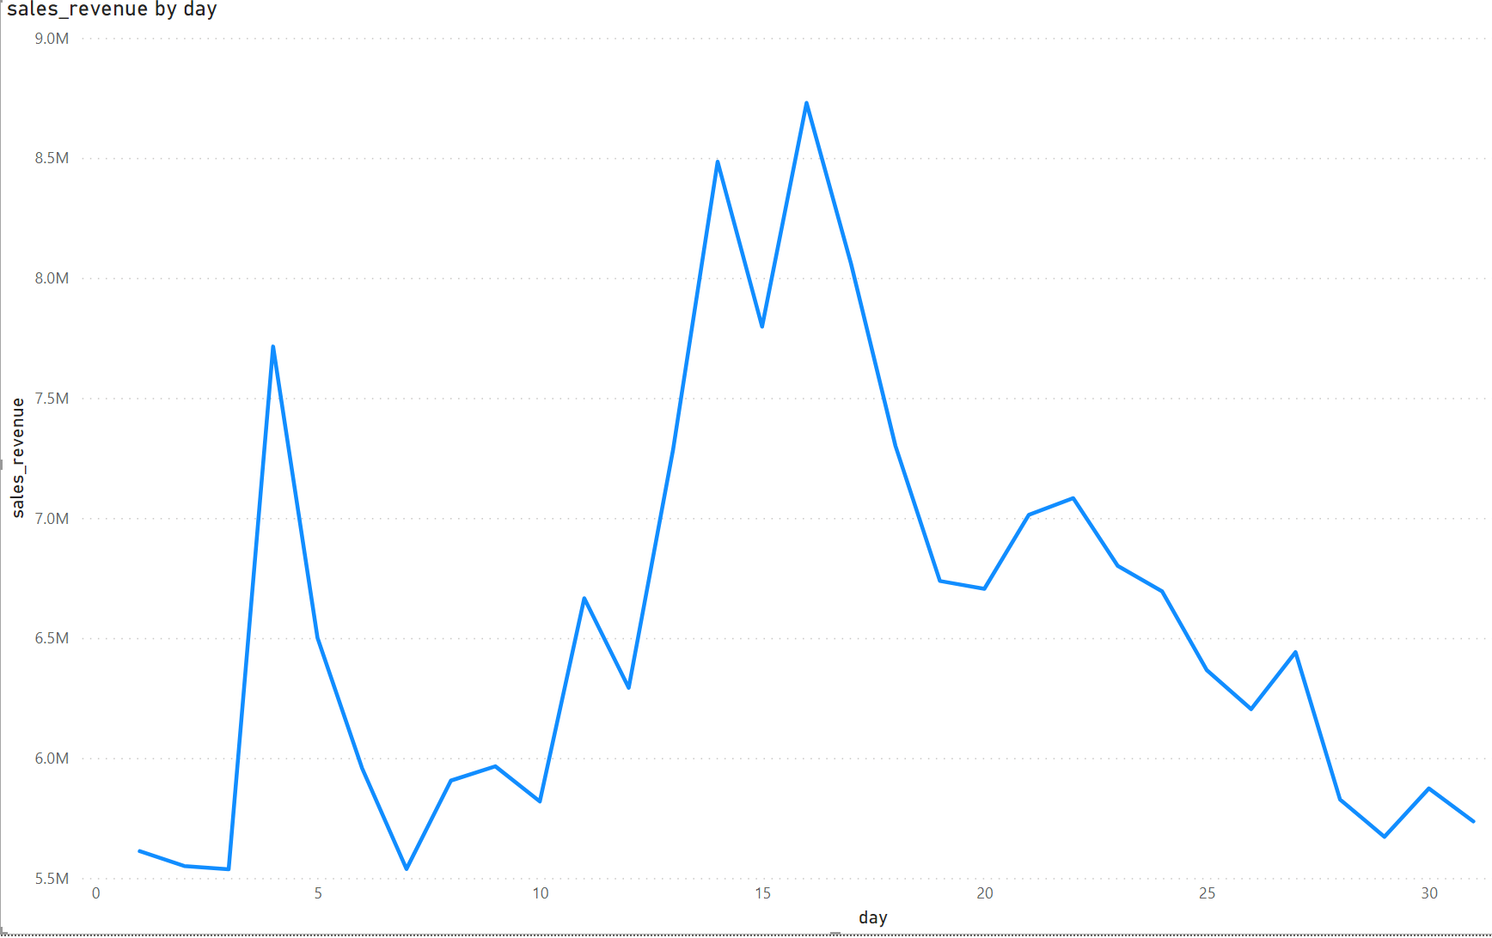
Analysis 1: Power BI Line Chart
Notes:
Using microsofts PoWer BI

Slide 11
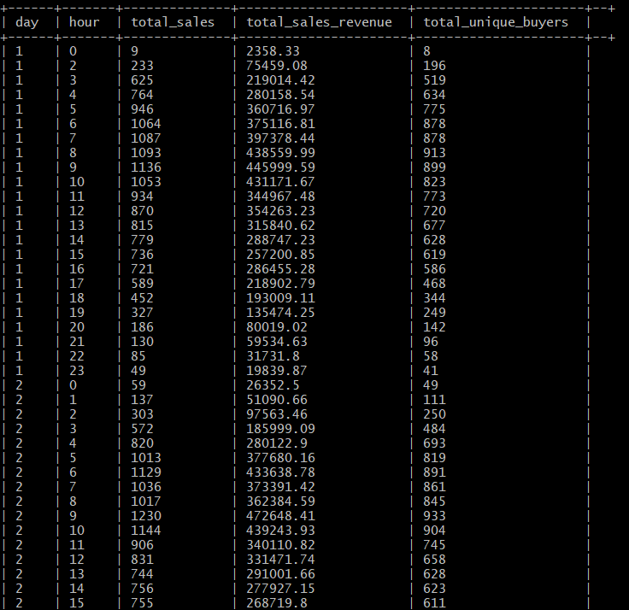
Query 2
Goal: To find the daily interaction of the ecommerce website
SELECT day, hour ,COUNT(event_type) AS total_sales, ROUND(SUM(price), 2) AS total_sales_revenue, COUNT(DISTINCT user_id) as total_unique_buyers FROM ecommerce_view WHERE event_type='purchase' GROUP BY day, hour ORDER BY day ASC, hour ASC;
Notes:
U

Slide 12
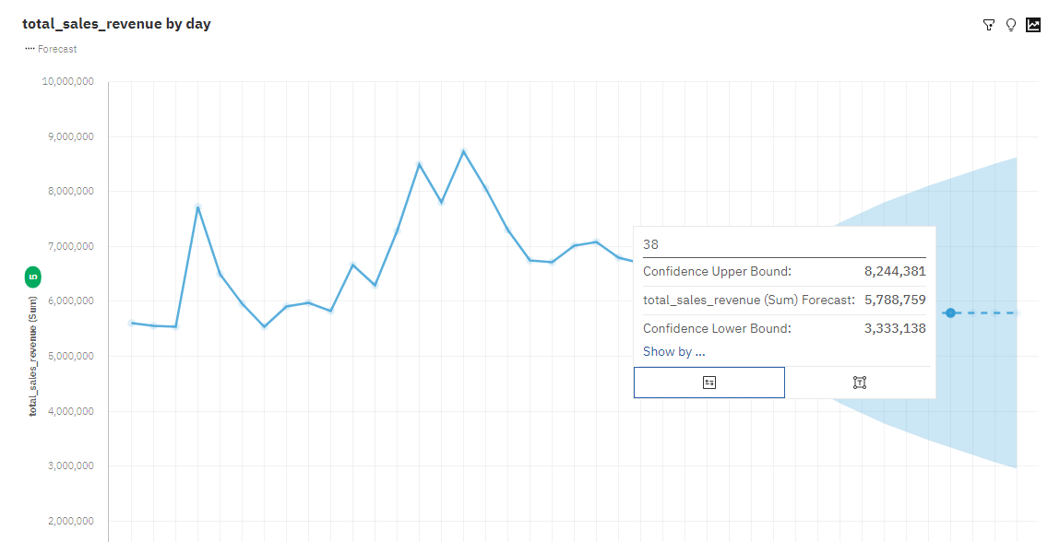
IBM Cognos - Forecasting Total Revenue

Slide 13
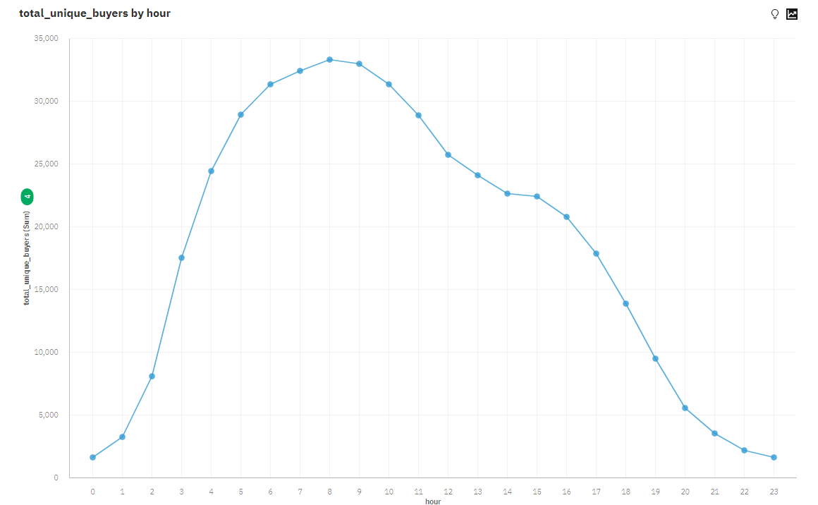
IBM Cognos - Trend Line Total Unique Buyers

Slide 14
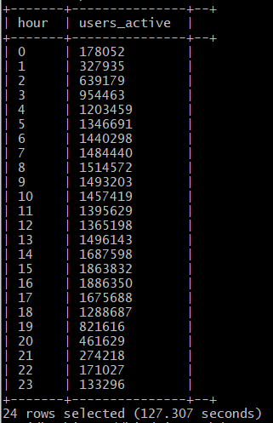
Query 3
Goal: To find user activity by hour
SELECT hour , COUNT(user_id) AS users_active FROM ecommerce_view GROUP BY hour ORDER BY hour ASC;
Notes:
U

Slide 15
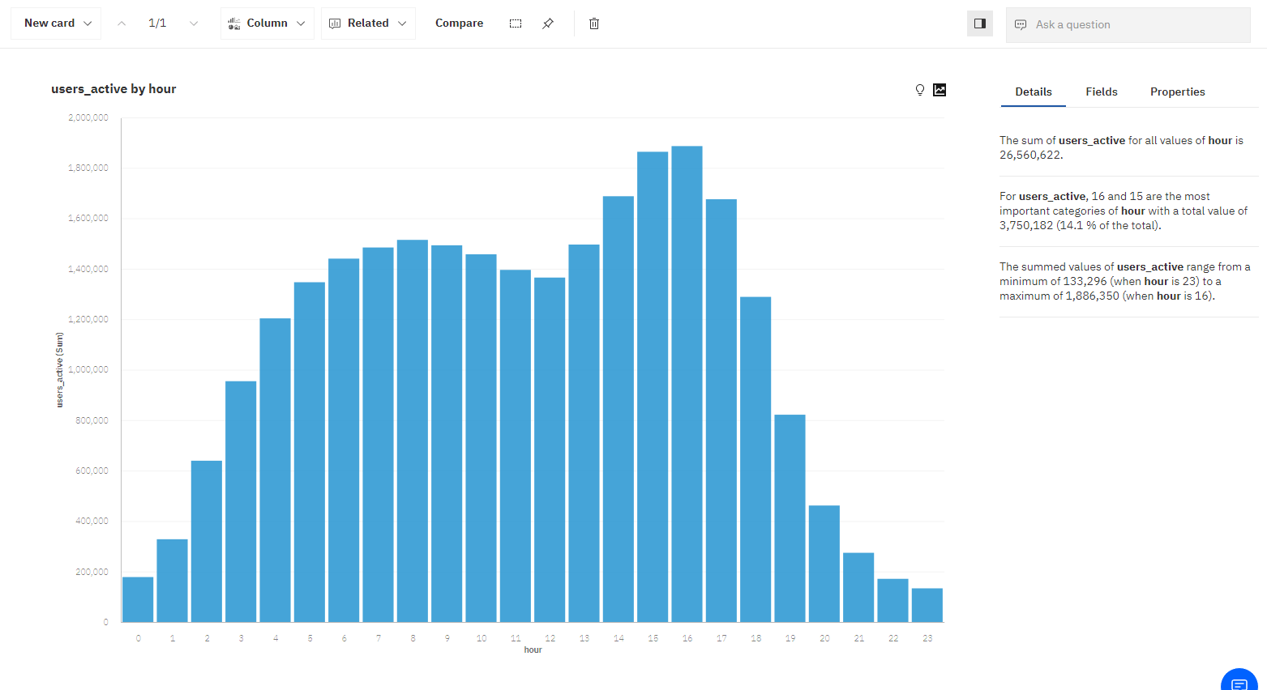
Analysis 3: IBM Cognos - Column Chart

Slide 16
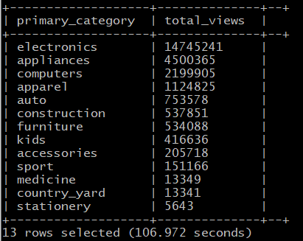
Query 4
Goal: To find the most popular category for viewing
SELECT primary_category, COUNT(event_type) AS total_views FROM ecommerce_view WHERE event_type = 'view' GROUP BY primary_category ORDER BY total_views DESC;
Notes:
U

Slide 17
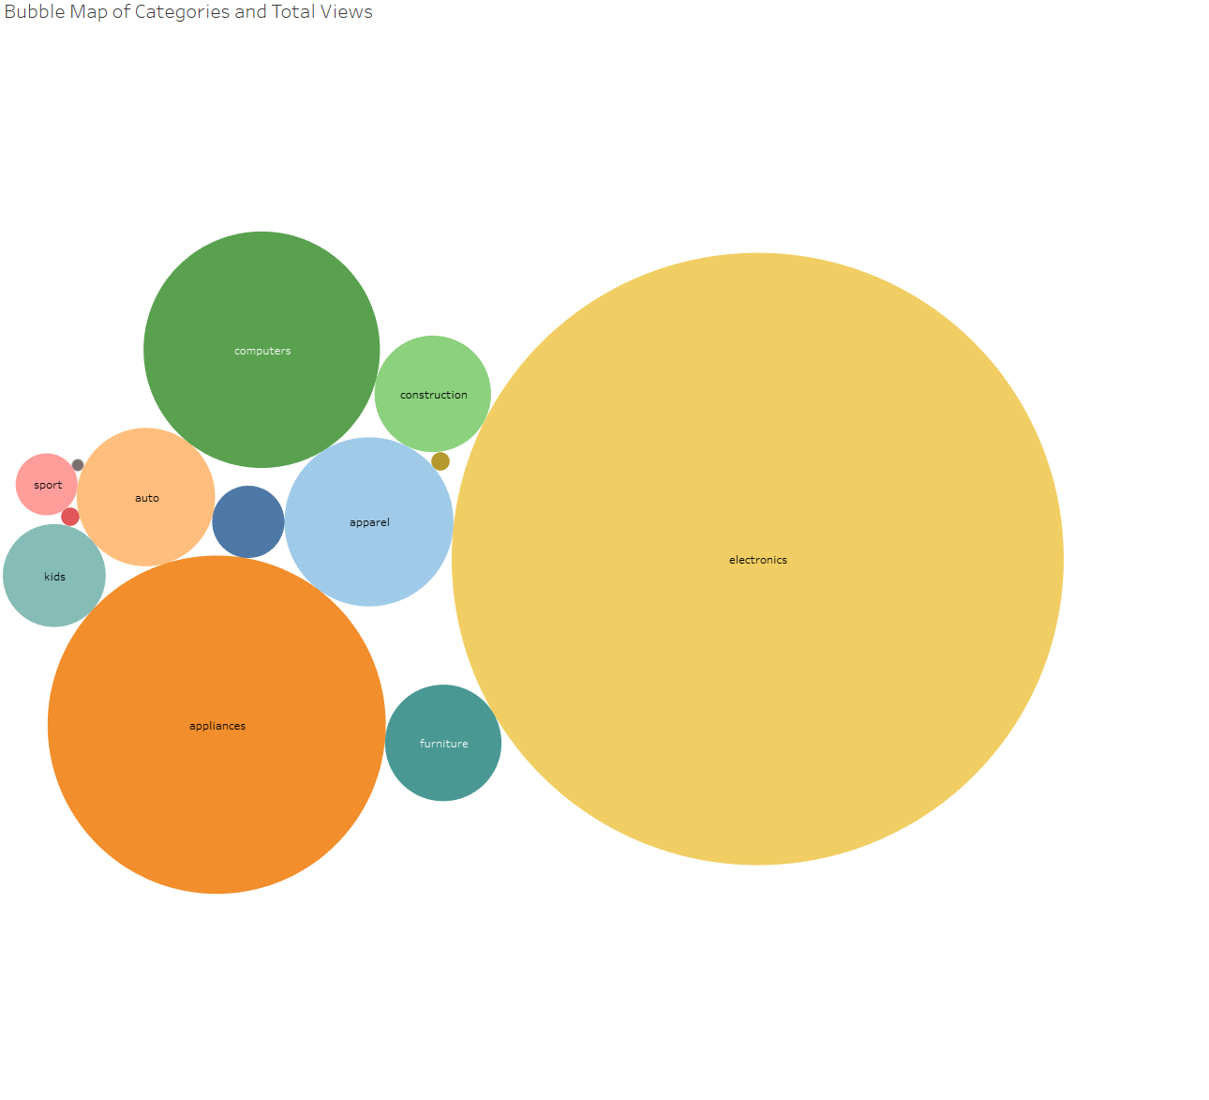
Analysis 4: Tableau Bubble Chart

Slide 18
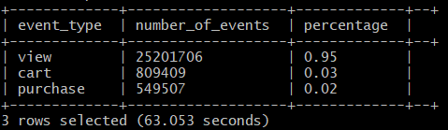
Query 5
Goal: To see the analytics of the event type
SELECT event_type,count(event_type) AS number_of_events, ROUND(CAST(COUNT(event_type) AS float)/26560622, 2) AS percentage FROM ecommerce_view GROUP BY event_type ORDER BY percentage DESC;
Notes:
U

Slide 19
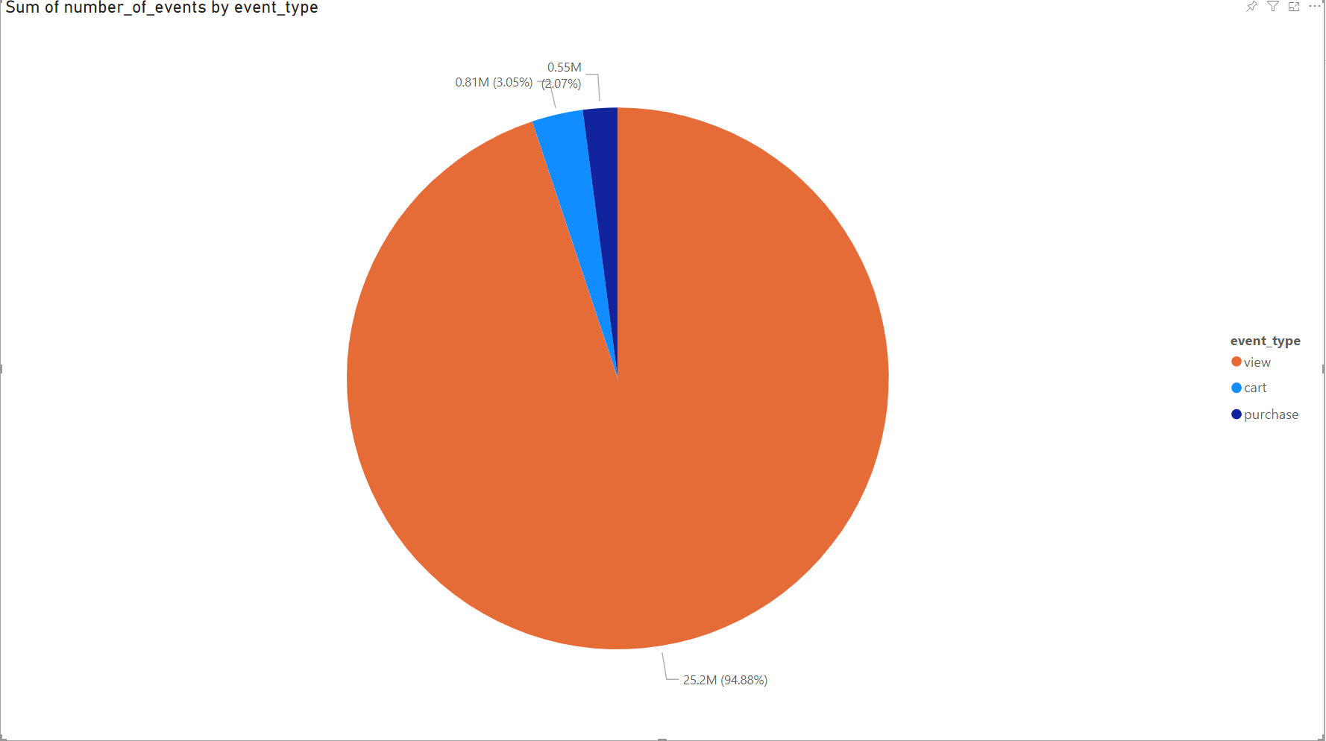
Analysis 5: Power BI Pie Chart

Slide 20
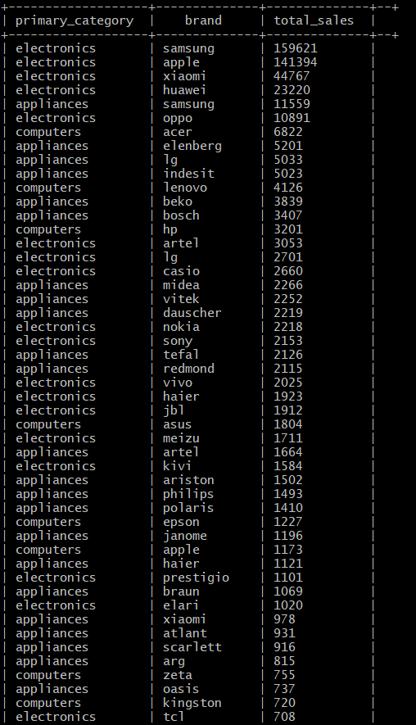
Query 6
Goal: To find total sales by product category and brand
SELECT primary_category, brand, COUNT(event_type) as total_sales FROM ecommerce_view WHERE primary_category IN('electronics', 'appliances', 'computers') AND event_type ='purchase' GROUP BY primary_category, brand ORDER BY total_sales DESC LIMIT 100;
Notes:
U

Slide 21
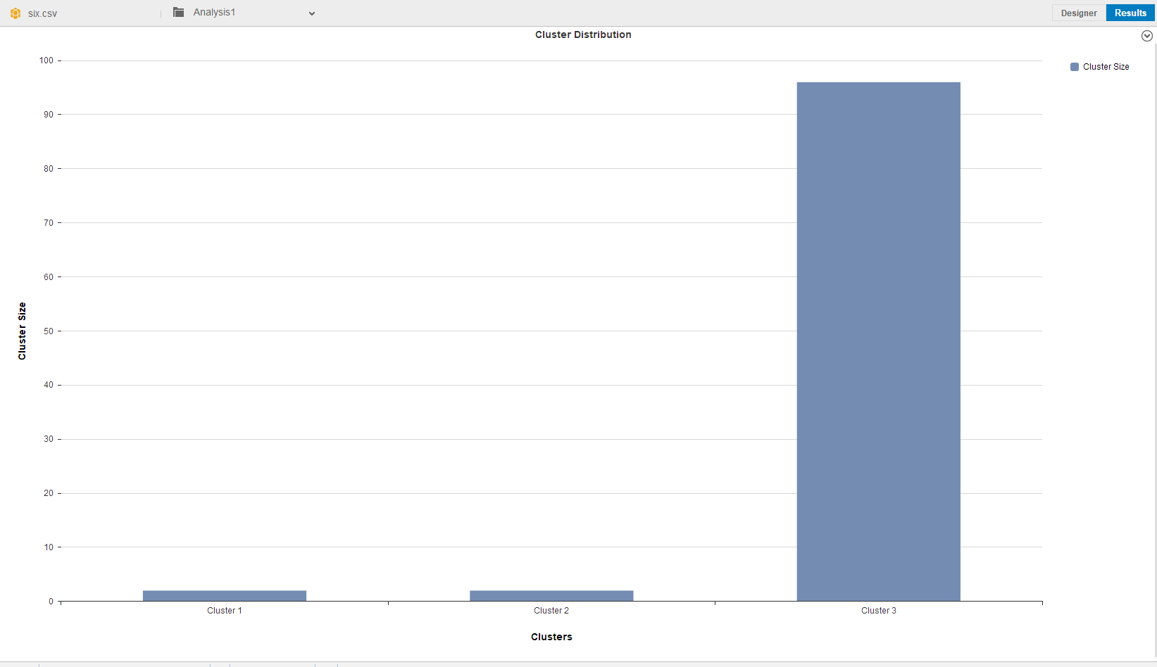
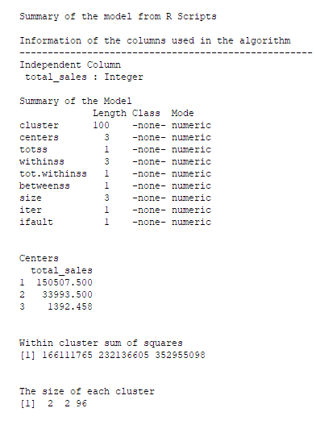
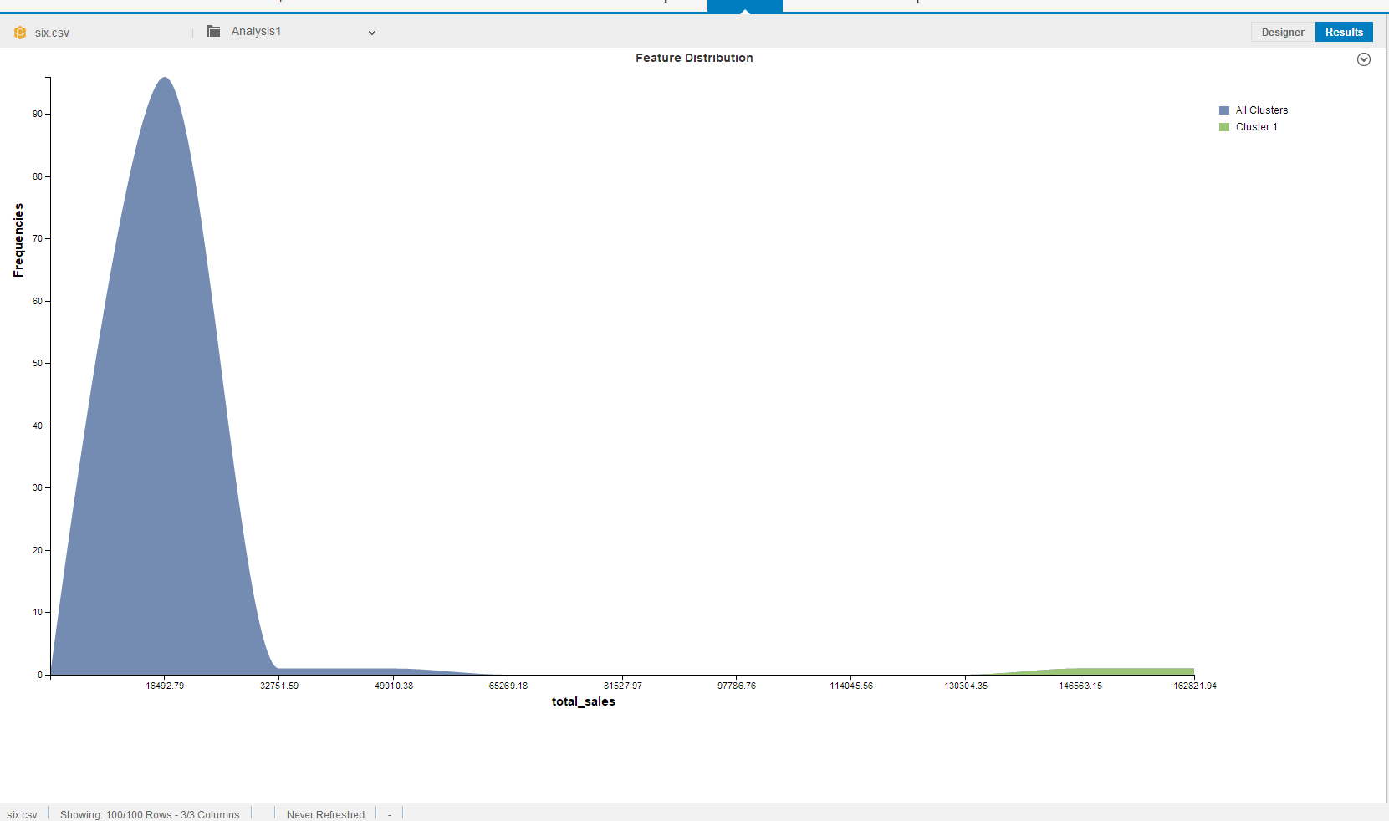
SAP Expert Analytics - K-Means- Analysis
Notes:
Most of the sales are on the low end in cluster 3. From this we see that buyers are price sensitive and prefer low cost electronic products.

Slide 22
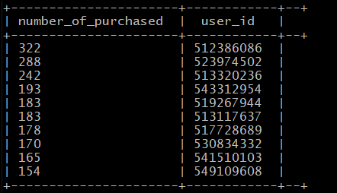
Query 7
Goal: To find out which customers made the most purchases
SELECT COUNT(user_id) as number_of_purchased,user_id FROM ecommerce_view WHERE event_type ='purchase' GROUP BY user_id HAVING number_of_purchased>1 ORDER BY number_of_purchased DESC limit 10;
Notes:
U

Slide 23
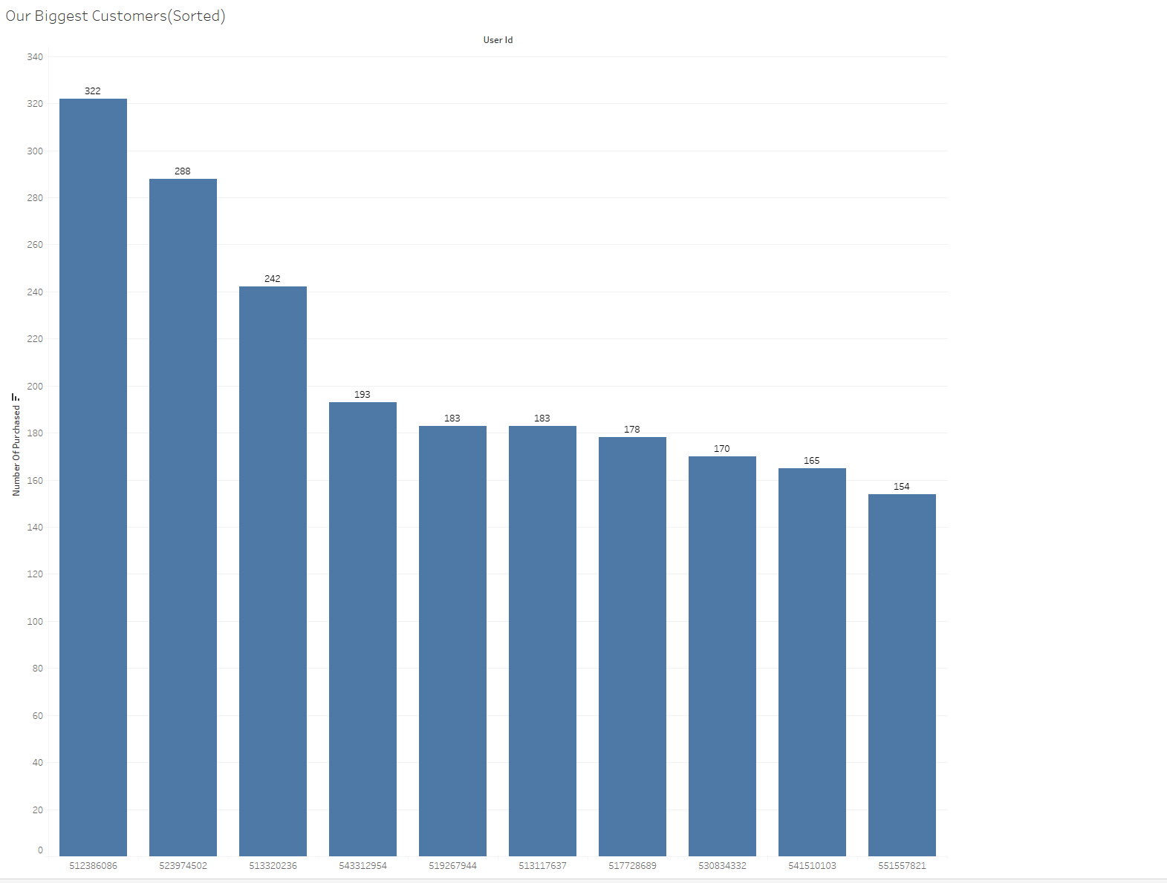
Analysis 7: Tableau Bar Chart
Notes:
Due to security reasons, the users are masked with an USER ID

Slide 24

Conclusion
Temporal Analysis results: Most users are active on 8 Universal Time (UTC) or 11:00 AM in PST.
For the month of October, the greatest peak in revenue is Day 16.
K-Means Analysis Results: Most records were part of cluster 03. Cluster 03 host the records that have the smallest total sale revenue.
The top three popular categories are electronics, appliances, and computers.
95% of customers view the products however only 3% move to cart and only 2% actually purchase.
Help business better understand their consumer base.

Slide 25

GitHub Link
https://github.com/neltf/CSULA_CIS_5200

Slide 26
References
Tan, Alson. “Visualising E-Commerce User Behaviours.” Medium, Techforshe, 8 Aug. 2020, medium.com/tech4she/visualising-e-commerce-user-behaviours-c833def97cc0.
Bilgic, Adil Emre. “E-Commerce Analytics.” Kaggle, Kaggle, 18 July 2020, www.kaggle.com/adilemrebilgic/e-commerce-analytics.
Yu, Andy. “Will Customers Buy the Products in Their Cart?” Medium, Towards Data Science, 20 Feb. 2020, towardsdatascience.com/will-customers-buy-the-products-in-their-cart-b8ac5e30f3.

Slide 27

Thank you

